Slide 1
Sentiment Analysis of Yelp User Review Data
Venkatesh

Slide 2
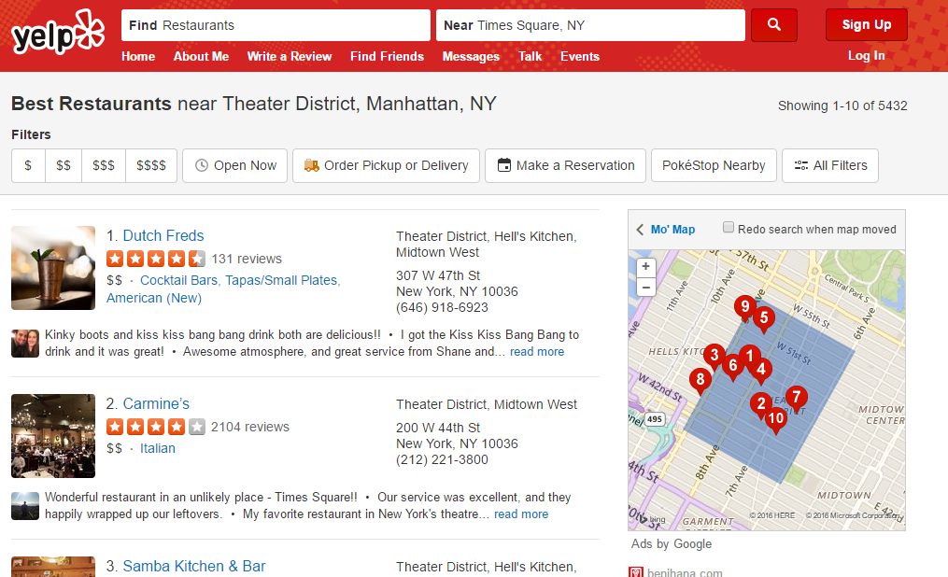
Yelp :

Slide 3
Web Scarping:
Scraped the top 210 restaurants in and around Times Square, New York City.
The data consists of the following items:
1. Name of the restaurant
2. Rating
3. Price Range
4. Number Of Reviews
5. Location
6. Reviews

Slide 4
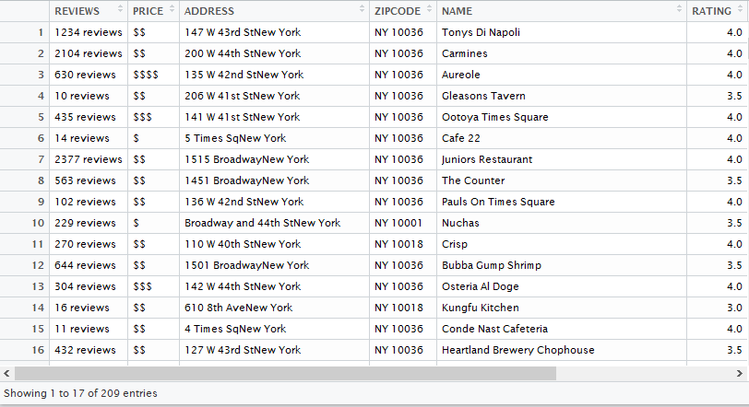
How the Data Looks after scraping and cleaning

Slide 5
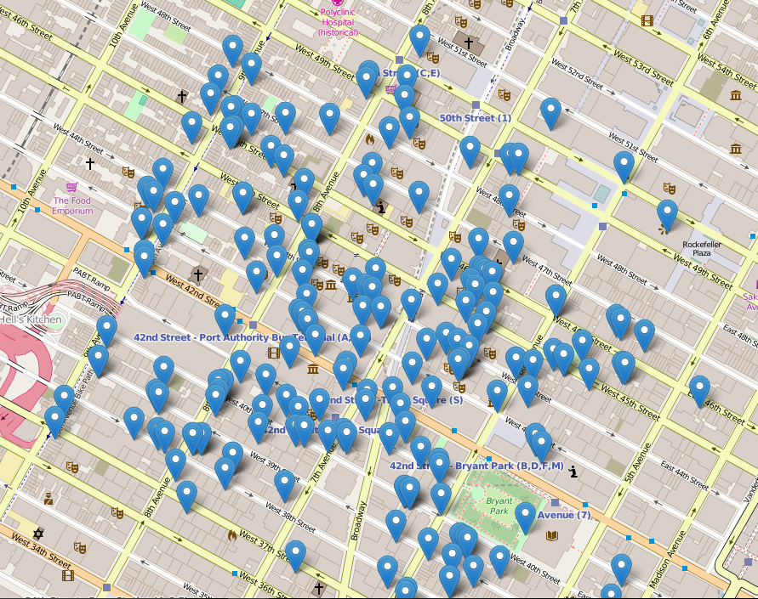
Exploratory Data Analysis:

Slide 6
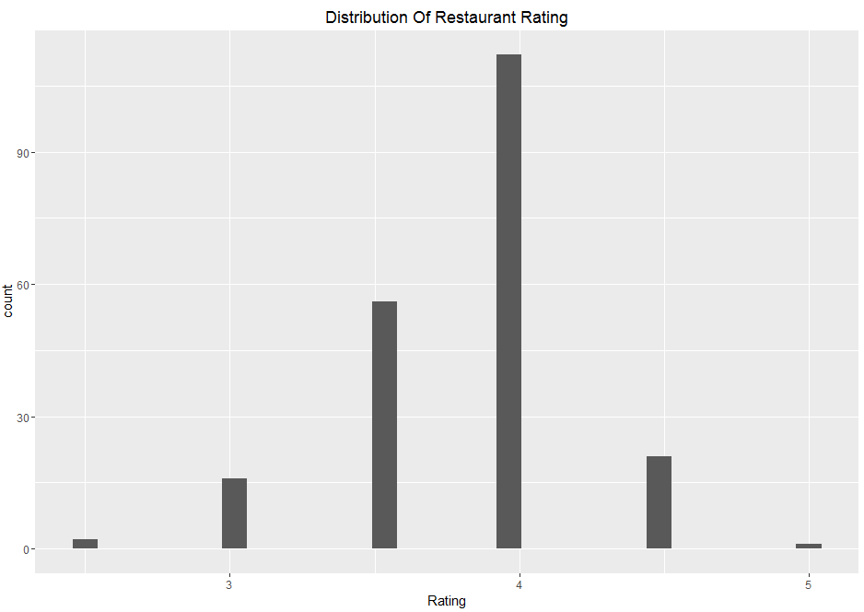
Exploratory Data Analysis:

Slide 7
Sentiment Analysis Of Yelp User Review Data
About The Data:
Yelp User Review Data is semi structured data
The data is just a sample out of the hundreds of reviews available. To be precise, the reviews presented in first page of each restaurant is scraped
Used VADER SENTIMENT ANALYSIS tool
VADER stands for Valence Aware Dictionary and sEntiment Reasoner

Slide 8
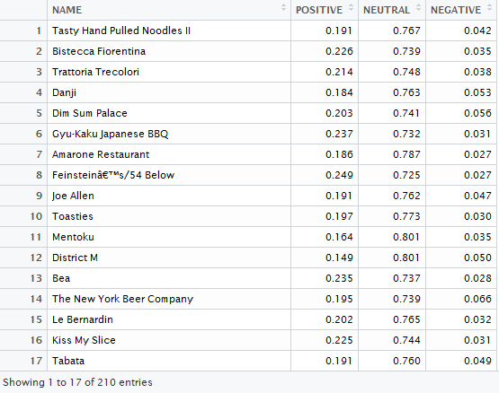
How the data looks after performing Sentiment Analysis:

Slide 9
Let’s Dive Into Shiny
https://venkatesh.shinyapps.io/yelp_scraping/

Slide 10
Thank You

